Slide 1
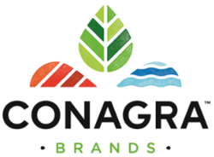
Explaining Consumers’ Purchasing Behavior Before and After COVID-19 Conagra Brands May/2021
TEAM 7:
Sarakshi Chandna
Hung Quoc Nguyen
Jeevan Matthew Varghese
Sandeep Gautam
Swathi Vepachedu
Sahithi Ari

Slide 2
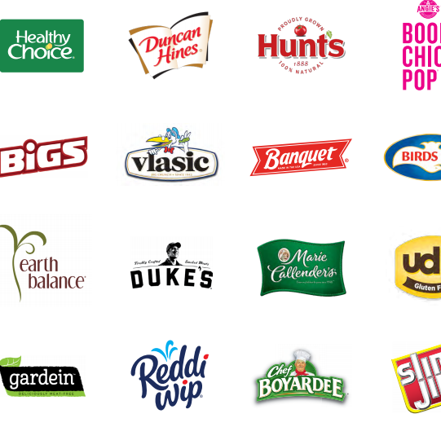

BUSINESS OVERVIEW
Conagra Brands have been making and selling products under various brand names for over 100 years. Their products are available in supermarkets, restaurants, and food service establishments.
~16,500
Employees
~$11 bn
Revenue
Chicago
Headquarters
~50
Facilities in US

Slide 3
PROJECT OVERVIEW
FROZEN MEALS – Important notes/ Sales pattern/ Price elasticity/ Flavor & Nutrition preference / Regional factor / Supporting Analysis
1
FROZEN VEGGIES– Key findings
2
POPCORN – Key findings
3
Marketing Strategy – Recommendations
4

Slide 4
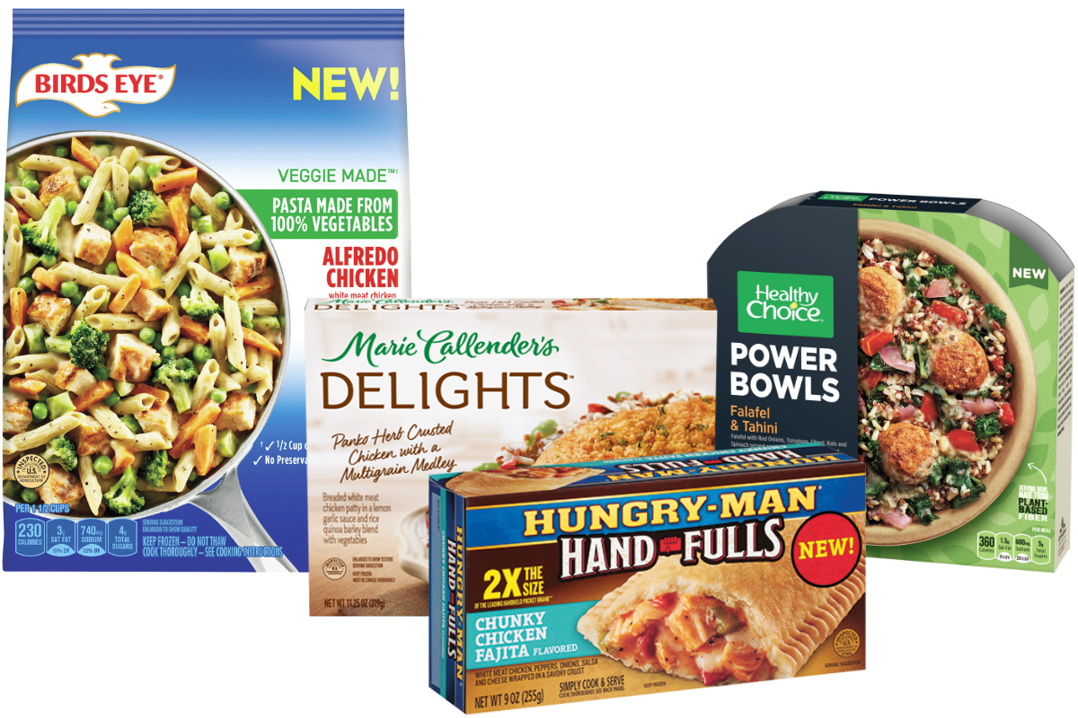
FROZEN MEALS

Slide 5
IMPORTANT NOTES
YEAR:
We perform our analysis based on monthly basic. Therefore, we eliminated all data points in Dec 2017 due to the lack of information
Further, all data between Jan 2018 and Feb 2019 is considered as the “Pre-COVID” period, and all data thereafter as “During COVID”
1
PRODUCT TYPE:
The FROZEN MEALS master data set consists of 74 product types that we further categorize into 18 core product groups based on the same characters of each product types. Please refer to APPENDIX 1 for the details.
Of the 18 product groups, the top 5 account for over 95% of the sales. These 5 groups have been the primary focus of our analyses
2
NUTRITION:
In order to examine if consumer behavior can be explained by the nutritional value of products, we add a new variable, nutrition level to the dataset. This variable was considered specifically catering to Conagra’s emphasis on nutritious food options
Each product type was assigned to one of 4 Nutrition groups. For the detail, please refer to APPENDIX 2.
3
PRIVATE LABEL/NATIONAL BRAND:
We acknowledge there are differences between NATIONAL BRAND and PRIVATE LEVEL in many aspects, therefore we present our analysis in two different groups accordingly, except for Nutrition level preference.
4
PARENT, FLAVOR/SCENT & PACKAGING GROUP:
While we respect Conagra’s commitment to the UN SDGs with packaging, we have eliminated this variable along with Parent and Flavor/Scent to offer more meaningful and targeted marketing insights
5

Slide 6
SALES PATTERN
UNITS SOLD
1
National brands account for 93% of total units sold from 2018 through 2020
2
In terms of revenue (Dollars), the top 5 product groups under both National brands and Private label account for over 95% of total revenue. Hereafter all analyses focus on these 5 groups for the two brands.
3
While demand prior to COVID was stationary (+/-20%), we observe a sudden increase in demand (+/-40%) after February 2020, right after COVID hit the US
%MOM CHANGE IN UNITS SOLD (*)
TOP 5 PRODUCT GROUPS
MEALS include 4 product types: ENTRÉE/DINNER/ DINNER OR ENTRÉE/MEAL KIT.
It’s noted that product type ENTRÉE alone account for ac.70% of total units sold in both brands..
High fluctuation right after COVID
(*) %MOM: percentage change month over month

Slide 7
UNITS SOLD
(*) %MOM: percentage change month over month
Notes:
National brand: MEALS is the major driver for revenue, then, 2nd MEXICAN & 3rd POCKET FOOD. We observe a bit wider variance in % month over month of units sold after COVID compare to before COVID, supporting the conclusion that COVID has impact on top selling National brand
Private label: MEALS is the major driver for revenue, then, 2nd SANDWICH & 3rd MEXICAN. We observe a downward trend for MEALS over time. The impact of COVID is not clear to Private label.

Slide 8
PRICE ELASTICITY
AVG PRICE CHANGE – NATIONAL BRANDS
AVG PRICE CHANGE – PRIVATE LABEL
BURGERNV shows Upward trend
AVG PRICE ELASTICITY – NATIONAL BRANDS
AVG PRICE ELASTICITY – PRIVATE LABEL
COVID has impact on monthly average price, BURGERNV experienced high variance in monthly price change (Var 0.36)
Surge in demand for SANDWICH before COVID
Notes:
Speaker notes –
Analyzing average monthly prices of TOP 5 NATIONAL BRAND product type groups, we observe there are different trends among those 5 groups:
Upward trend and most fluctuating: BURGERNV, with Var(% monthly Price change ) = 0.36
Slight movements: MEXICAN, MEALS, POCKET FOOD, HOT DOG, and SANDWICH with Var(%monthly price change) ranging from 0.01 – 0.05.
We also observe that COVID has impact on the Price change of TOP 5 groups regarding to the wide fluctuation of % monthly price change before vs. after COVID of BURGERNV, MEXICAN and SANDWICH
The trend of average month price of TOP 5 in PRIVATE BRAND is more stable compared to NATIONAL BRAND. We also observe that COVID does not show a significant impact on the Price change of TOP 5 groups in PRIVATE BRAND

Slide 9
FLAVOR PREFERENCE & NUTRITION
UNITS SOLD BY NUTRITION
UNITS SOLD BY FLAVOR/SCENT
1
TOP 5 Flavors based on units sold include: Meat, Poultry, Cheese, Tangy and Other Flavors. We don’t observe a significant change in Flavor/Scent preference before and after COVID
While we observe a sudden spike across products of nutritional levels after COVID, there are still no significant trends. The AVG.HIGH products (High calories, >5% DV, and High protein, >20% DV) are still dominating the portfolio. We especially notice that GOOD products (Low calories, High protein) have very few units sold compared to others.
2
Notes:
Speaker notes –
We observe a high demand at all NUTRITION LEVEL after COVID, in Mar/2020, then, a sharp decrease in demand in the following month.
GOOD (or healthy) products, including VEGETARIAN BURGER, experienced a significant increase in demand right after COVID. But, in other side, the units sold is relatively small compared to other products. There is not enough evidence to say there is any significant change in demand regarding to nutrition level before and after COVID.

Slide 10
REGIONAL FACTOR
UNITS SOLD BY REGION – NATIONAL BRAND
UNITS SOLD BY REGION – PRIVATE LABEL
1
NATIONAL BRAND: We observe a short-term HIGH DEMAND from all four regions in Mar/2020, then, a sharp DECREASE in the following month. There is similar pattern in all four markets.
2
PRIVATE LABEL: We observe a high demand at all four regions after COVID, then, a sharp decline in demand.
In general, we observe slight downward trends in MIDWEST/ WEST/ SOUTH from 2018 to 2020
We observe a significant increase in demand in MIDWEST in Nov/2020
3
WEST is the best market for both NATIONAL BRAND and PRIVATE LABEL. The demand shows a stationary pattern on monthly basic under the study period. The monthly changes are likely associated with changes to (1) pricing strategy or (2) product packages rather than the COVID outbreak over the study period.

Slide 11

SUPPORTING ANALYSES – SUMMARY
OVERALL
NATIONAL BRAND
PRIVATE LABEL
There does not seem to be a very significant difference in demand overall before and after COVID
West, followed by Midwest regions offered significantly higher sales than Northeast and South. This trend continued during COVID as well
There is a strong demand for National Brands among product group across regions compared to private brands
Mexican food, followed by Meals significantly effect increase in sales
There is no significant impact of all nutrition levels on sales
There has not been significant change in demand for National brands before and after COVID
Like the overall results, West and Midwest have a significantly larger demand for national brands before and after COVID
Within national brands, meals with Avg low and Avg high nutrition value enjoy the most demand before and after COVID
Additionally, in the West, consumers significantly prefer meals with Avg low nutritional level
There is no statistically significant effect of the pandemic on demand for private label frozen meals
Midwest is potentially the only strong market for Private Labels, with a strong preference for meals with Avg high and Avg low nutrition value. While the West prefers meals with a Bad nutritional value.
Notes:
To further analyze if there were any specific factors effecting preference for a particular product type – we ran a multinomial regression

Slide 12
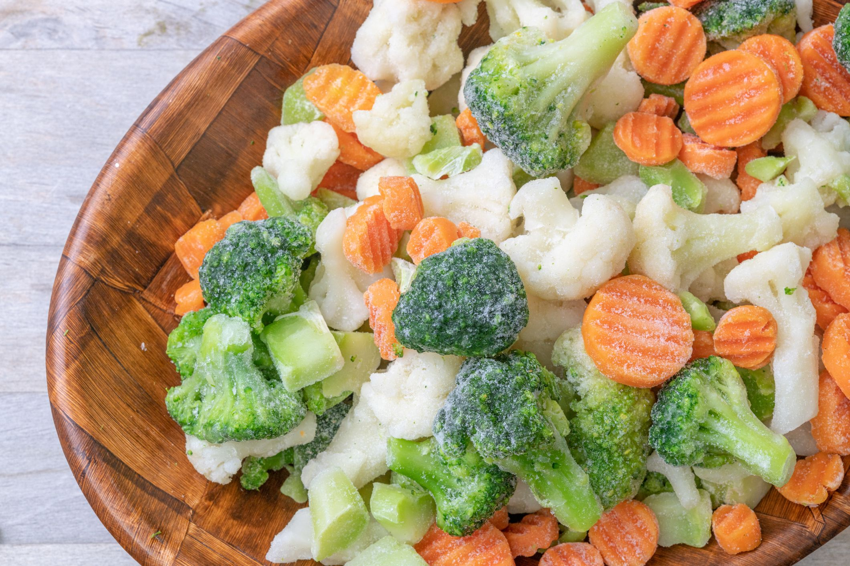
FROZEN VEGETABLES

Slide 13
DATA PROCESSING OF FROZEN VEGETABLES
UPC, PRODUCT DESCRIPTION,MANUFACTURER, MAJOR BRAND, BRAND :
We removed all these columns from the data. These columns are very similar in nature and parameters such as 'UPC' had a lot of unique variables which would have hampered the analysis.
1
YEAR:
Dates preceding March 2020 were labeled as 'PRE COVID' and following March 2020 were labeled as 'POST COVID'
2
PACKAGING:
Since the Bag variable under packaging column have more than 95% of the total Sales, the data was categorized into two groups; i.e 'Bag' & 'Others'.
3
PARENT:
PARENT columns had 4 categories that contains more 90% of the total sales amount, we split the data into 5 groups, namely-PRIVATE LABEL, PARENT 1,2, and 3 and others.
4
PRODUCT
Regarding the product like top 10 product like MIXED VEGETABLE, BROCCOLI, BEANS etc., contained 92% of total sales. Hence, the data was categorized into 11 categories i.e., top 10 sales vegetable and others as one category different category
5

Slide 14
OVERVIEW – UNITS & REVENUE
1
National brands account for 61% of total units sold from 2018 through 2020 unlike the 93% we see within the Frozen Meals observation
2
We see a cyclic fluctuation from 2017 to January 2020 which would be the expected path for the following year. Once COVID begins, we see a 38% increase in sales and a 20% increase in expected sales
3
In terms of revenue, the top 5 product groups under National brands and Private label account for over 77% of the total units sold and over 75% of the total revenue.
TOP 5 PRODUCT GROUPS
 | NATIONAL BRAND (12/2017-12/2020)
 |  | UNITS | % | DOLLARS | % | AVG.PRICE
1 | MIXED VEGETABLE | 1,971,837 | 31% | 4,008,863 | 30% | 2.03
2 | BROCCOLI | 924,105 | 14% | 2,085,188 | 16% | 2.26
3 | CORN | 803,145 | 12% | 1,260,416 | 9% | 1.57
4 | BEAN | 691,705 | 11% | 1,333,319 | 10% | 1.93
5 | PEAS | 607,803 | 9% | 1,011,318 | 8% | 1.66
 | PRIVATE LABEL
 |  | UNITS | % | DOLLARS | % | AVG.PRICE
1 | MIXED VEGETABLE | 3,090,052 | 28% | 4,939,236 | 31% | 1.60
2 | BROCCOLI | 1,832,019 | 16% | 2,798,829 | 17% | 1.53
3 | BEAN | 1,440,523 | 13% | 1,989,629 | 12% | 1.38
4 | CORN | 1,195,369 | 11% | 1,601,846 | 10% | 1.34
5 | PEAS | 975,625 | 9% | 1,325,181 | 8% | 1.36

Slide 15
PRICE ELASTICITY
Notes:
Speaker notes –
Analyzing average monthly prices of TOP 5 NATIONAL BRAND product type groups, we observe there are different trends among those 5 groups:
Upward trend and most fluctuating: BURGERNV, with Var(% monthly Price change ) = 0.36
Slight movements: MEXICAN, MEALS, POCKET FOOD, HOT DOG, and SANDWICH with Var(%monthly price change) ranging from 0.01 – 0.05.
We also observe that COVID has impact on the Price change of TOP 5 groups regarding to the wide fluctuation of % monthly price change before vs. after COVID of BURGERNV, MEXICAN and SANDWICH
The trend of average month price of TOP 5 in PRIVATE BRAND is more stable compared to NATIONAL BRAND. We also observe that COVID does not show a significant impact on the Price change of TOP 5 groups in PRIVATE BRAND

Slide 16
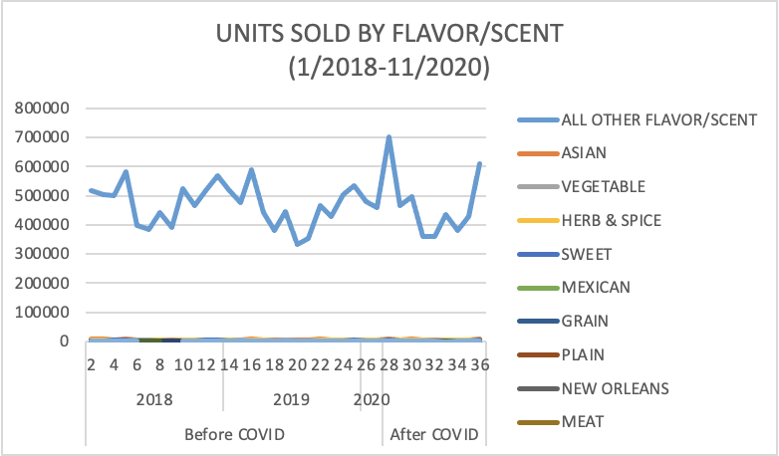
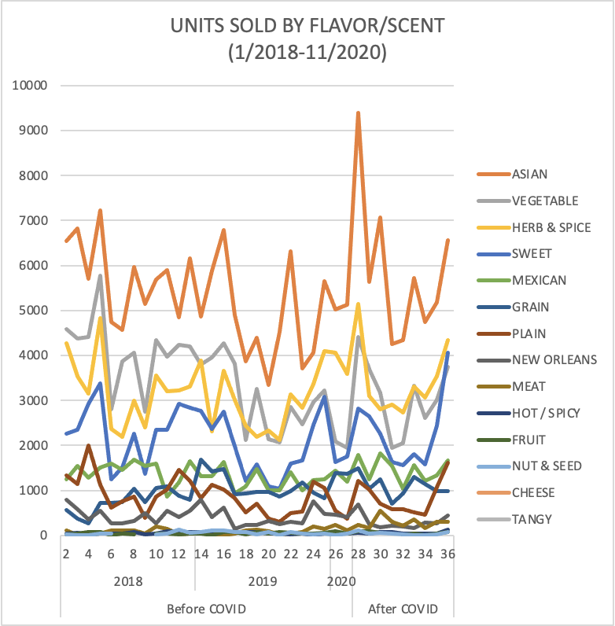
FLAVOR PREFERENCE
TOP 5 Flavors based on units sold include (excluding All Other Flavors & Scents):
1. Asian
2. Vegetable
3. Herb & Spice
4. Sweet
5. Mexican
1
The secondary figure excludes the field 'All Other Flavors and Scents', we see similar trends among most product flavor/scents, however a high emphasis on nutritional products spikes immediately followed by a sharp decline. Ref. Slide 9 on nutritional trends to examine similar results.
2
Notes:
Speaker notes –
We observe a high demand at all NUTRITION LEVEL after COVID, in Mar/2020, then, a sharp decrease in demand in the following month.
GOOD (or healthy) products, including VEGETARIAN BURGER, experienced a significant increase in demand right after COVID. But, in other side, the units sold is relatively small compared to other products. There is not enough evidence to say there is any significant change in demand regarding to nutrition level before and after COVID.

Slide 17
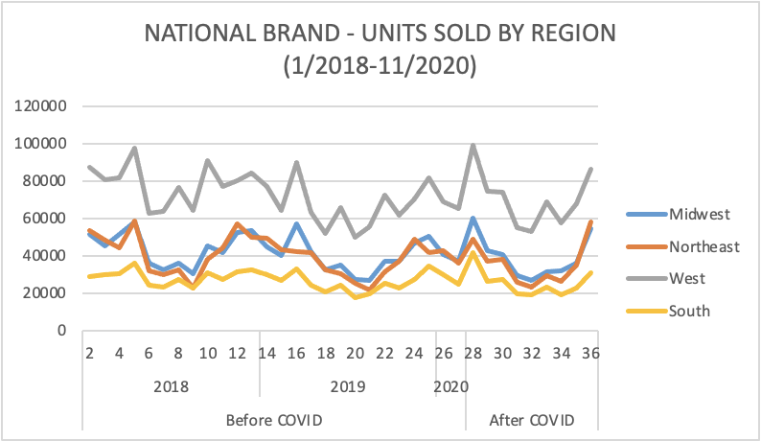
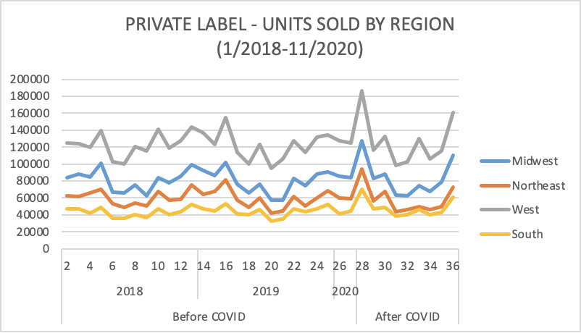
REGION
1
NATIONAL BRAND: We observe a HIGH DEMAND from all four regions after COVID; in terms of % change, within National Brands, the change is highest for the Midwest and West regions. As expected, there is a decrease in all 4 regions, however it is the most observable in West relatively.
PRIVATE LABEL: We observe a high demand at all four regions after COVID, then, a sharp decline in demand just as with the National Brand.
West Region experienced a sharp peak followed by a 45% decrease in the unit sales
Midwest follows the same sharp peak followed by a 47% decrease in unit sales
The differences are significant to observe when comparing Private vs. National Brands in Midwest, Northeast, & South "After-COVID". The fluctuations in regional sales outside of COVID's impact in specific regions can be due to pricing strategies.
2

Slide 18
SUPPORTING ANALYSES – UNITS
COVID
REGION
PARENT
PRODUCT TYPE
FLAVOR
OVERALL : There does not seem to be a very significant difference in demand overall before and after COVID. With COVID, the UNIT sales went up and we see the COVID variable having positive impact in the UNITS sales at a significant level
NATIONAL & PRIVATE BRANDS: Both brand types had similar directions in terms of fluctuations during COVID, with more dynamic changes with Private Labels, however this does not constitute COVID's impact on Private vs National Brand sales
OVERALL: On an average Northeast and Southhave relatively less unit sales whereas West seemed to have high average sales.
COVID IMPACT: We observe increase in demand for all the region because of COVID except for in Northeast specifically for the National Brand
NATIONAL & PRIVATE BRANDS: However, although COVID might not have had an impact overall, it might have had an impact in Northeast due to pricing or marketing
OVERALL: It is observed that Flavor/Scent factors follow the same direction as factors explored previously. The beginning of COVD had a short-term impact, but in the long term these all Flavor/Scent items restabilized overall
COVID IMPACT: COVID had varying short-term impacts on various Flavor/Scent items. The highest grossing categories followed the overall direction while more miniscule categories had differing fluctuations causing the overall regression to be significant for the parameter overall
OVERALL: Parent 2 and 3 have significantly high number of Sales on an average. However, 5 and 7 seems to have less than the average sales unit.
COVID IMPACT: Although Parent 2 and 3 were selling in signifciant higher no. than other brands, because of COVID its average sales unit decreased compared to other Parents. Also, parent 5 and 7 have a relatively negative impact of COVID.
OVERALL: Frozen Vegetables on an average product like Broccoli, Sprout, Cauliflower, Corn, Mixed Vegetables, and Others have significant higher UNIT sales whereas Okra have significant lower unit sales.
COVID IMPACT: Although the only product that seems to have been impacted was Zucchini

Slide 19

POPCORN

Slide 20
DATA OVERVIEW
PARENT GROUP:
The master data set consists of 118 product types that were further categorized into 7 core product types based on their corresponding food group
1
PRODUCT TYPE:
The master data set was classified into 4 groups and were factorized
2
PRIVATE LABEL/NATIONAL BRAND:
In addition to a more general analysis of the data, to better understand market trends for the two brands (private/national), data was divided accordingly and analyzed
3
PRODUCT DESCRIPTION, MAJOR BRAND, MANUFACTURER, UPC & CATEGORY:
We removed the above variables to offer more meaningful and targeted marketing insights
4
FACTORIZATION OF CATEGORICAL VARIABLES:
Variables such as Packaging type, region, product type, etc. were factorized to perform regression analysis on the data.
5

Slide 21
SALES PATTERN
1
National brands account for 74% of total units sold from 2018 through 2020
2
While demand prior to COVID was (+/-47%), we observe a slight increase in demand (+/-53%) after February 2020, right after COVID hit the US
3
In terms of revenue, out of 4 product groups, Microwaveable popcorn has the highest market share (81%) in National brand and 79% for Private label.
TOP 5 PRODUCT GROUPS
Notes:
National brands accounted for 74% of the total units sold through 2018-2020. And while there was variation in demand even was before covid, there was a definite spike in March after the Covid impact as people started panic buying and hoarding. Microwaveable popcorn had the highest market share in both National and Private label at 81% and 79% respectively. And national brands had higher sales than Private labels throughout.

Slide 22
PRICE ELASTICITY
Notes:
Speaker notes –
Speaking of Price elasticity, we observe different trends:
With change in price, Kernel popcorn dd seems to be affected the most till 2019. However, later we see the pattern get less volatile and become stagnant like others for national brand. This could be a possible effect on Covid.
The trend of average month price of PRIVATE BRAND is more stable compared to NATIONAL BRAND except for a one time spike in early 2019. We also observe that COVID does not show a significant impact on the Price change of PRIVATE BRAND

Slide 23
FLAVOR PREFERENCE
TOP 5 Flavors based on units sold include (excluding All Other Flavors & Scents):
1. Butter
2. All other flavor/scent
3. Sweet
4. Herb & Spice
5. Cheese
1
2
The secondary figure shows the month over month change in units by flavors. We see similar trends among most product flavor/scents, however, there is a decrease in the ‘Hot & Spicy’ flavor after COVID.
Notes:
Speaker notes –
In flavor preference we see that butter is the most preferred flavor in popcorns with a significantly high dd than others. flavors other than sweet, herb&spice, cheese and fruit are preferred most after the classic butter popcorn. And we can also see the temporary increase on the sales of these flavors after covid.

Slide 24
REGION
1
NATIONAL BRAND: We observe a HIGH DEMAND from all four regions after COVID; in terms of % change, within National Brands, the change is highest for Midwest & west regions . As expected, there is a decrease in all 4 regions, however it is the most observable in the west region relatively.
PRIVATE LABEL: We observe a high demand at all four regions after COVID, then, a sharp decline in demand just as with the National Brand.
West region experienced a sharp peak followed by a ~25% decrease in the unit sales
Midwest region follows the same sharp peak followed by a ~21% decrease in unit sales
The differences are significant to observe when comparing Private vs. National Brands in Midwest (N Central), Northeast, West, and South“ After-COVID". The fluctuations in regional sales outside of COVID's impact in specific regions can be due to pricing strategies.
2
Notes:
We observe a HIGH DEMAND from all four regions after COVID; in terms of % change, within National Brands, the change is highest for Midwest & west regions . As expected, there is a decrease in all 4 regions, however it is the most observable in the west region relatively. PRIVATE LABEL: We observe a high demand at all four regions after COVID, then, a sharp decline in demand just as with the National Brand.
West region experienced a sharp peak followed by a ~25% decrease in the unit sales
Midwest region follows the same sharp peak followed by a ~21% decrease in unit sales
The differences are significant to observe when comparing Private vs. National Brands in Midwest (N Central), Northeast, West, and South“ After-COVID". The fluctuations in regional sales outside of COVID's impact in specific regions can be due to pricing strategies.

Slide 25
SUPPORTING ANALYSES – UNITS
COVID
REGION
BRAND
PRODUCT TYPE
FLAVOR
OVERALL : Demand spiked in March 2020 after covid because of panic buying difference in demand before and after COVID
NATIONAL BRANDS: We see similar results corresponding to changes in sales of national branded products as well
PRIVATE LABEL: Although we only see directional support for higher sales during COVID, it is not statistically significant
OVERALL: West and Midwest regions have significantly higher demand before and after COVID
NATIONAL BRANDS: We observe a similar demand for national branded products in the West and Midwest regions. There is also no meaningful effect of COVID on sales across regions
PRIVATE LABEL: For private label products, however, we see significantly higher demand in the Midwest. There is so effect of COVID on sales across regions
OVERALL: A significantly high number of national branded products were sold.
The ratio of number of sales increased for private brands after COVID.
OVERALL: it is observed that Flavor/Scent factors follow the same direction as factors explored previously. The beginning of COVD had a short-term spike, but in the long term these all Flavor/Scent items re-stabilized overall
COVID IMPACT: COVID had varying short-term impacts on various Flavor/Scent items. The highest grossing categories followed the overall direction while more miniscule categories had differing fluctuations causing the overall regression to be significant for the parameter overall.
OVERALL: Microwaveable popcorn group had significantly higher sales than other types before and after COVID
NATIONAL BRANDS: From national branded popcorns, the same trend continues before and after COVID across regions
PRIVATE LABEL: From private labelled meals, the same trend continues before and after COVID across regions

Slide 26
MARKETING STRATEGY RECOMMENDATIONS

Slide 27
MARKETING RECOMMENDATIONS
REBRANDING CONAGRA
REGION & NUTRITION
STRATEGIC TARGETING
PERSONALIZATION
ConAgra should focus its marketing efforts on repositioning itself as a leader in sustainable food packaging and plant-based options. This would help the brand further its mission and offer a unique standing in a rapidly growing segment of the market
Frozen Meals: West & Midwest are Conagra’s highest selling markets. In all 4 regions, current preference is very low for “good” nutrition value products. Given ConAgra’s commitment to the UN SDGs, we recommend that marketing efforts shift focus to these products in addition to the existing popular foods
Frozen Vegetables: For National Brands, the Northeast shows promising fluctuations, even through COVID. For Private Brands, we see a similar observation for the Midwest region. It is recommended that ConAgra continue pushing efforts in the West for all Brands, the Northeast for National Brands, and Midwest for Private Brands.
Frozen Meals & Vegetables: With US’ growing Gen-Z & Millennial population, marketing efforts must prioritize young working adults who are increasingly choosing healthier and sustainably packaged options
Popcorn: The primary target group for popcorn must be children and teens. Investing in store features and placing these product at an eye level visible to children would offer a great head start.
We recommend ConAgra to send personalized ad flyers and weekly coupons to customers based on dynamic user profiles and purchase history. By linking multiple data points around factors such as flavor, brand, choice, etc. for all 3 product categories including frozen meals, frozen vegetables and popcorn, ConAgra can better understand each consumer’s behavior and offer personalized product suggestion

Slide 28
APPENDICES

Slide 29
DEFINING NUTRITION LEVEL
The variable Nutrition, used in our analyses was developed using the following framework –
- We use % Daily Values (DV) as a guide. Daily Values provide the average level of nutrients of a food/product for a person eating 2,000 calories a day.
There are 4 levels of nutrition in our analysis:
For the list of Nutrition level for each PRODUCT TYPE, please refer to APPENDIX
NUTRITION LEVEL | CALORIES | PROTEIN
Bad | High (>5%) | Low (<20%)
Average.High | High (>5%) | High (>20%)
Average.Low | Low (<5%) | Low (<20%)
Good | Low (<5%) | High (>20%)

Slide 30
1. Reference list of Product type groups – FROZEN MEALS

Slide 31
2. PRODUCT TYPE & NUTRITION LEVEL – FROZEN MEALS

Slide 32
THANK YOU!

